Slide 1
Genetics in Paediatric Surgery
Niveditha Shama V
15.04.2023

Slide 2
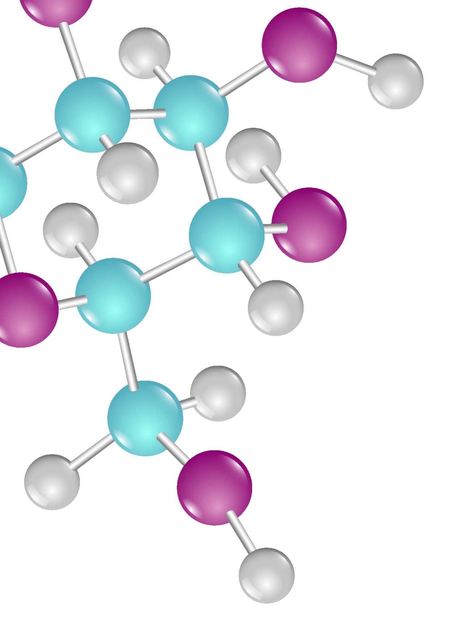
Overview
Definitions
Classification of genetic disorders
Associations with surgical conditions
Evaluation/workup
Prevention
Specific common conditions

Slide 3
Definitions
Genes
Specific sequences of bases that encode instructions for how to make proteins
Genome
Total composition of genetic material within a cell
Chromosome
Large units of genome
Physically separate molecules
23 pairs of chromosomes
22 autosomes (numbered 1 through 22)
One pair of sex chromosomes (XX or XY)

Slide 4
Types of Genetic disorders
01
Single gene disorders
03
Chromosomal disorders
02
Genomic disorders
04
Multifactorial conditions

Slide 5
SINGLE GENE DISORDERS
GENOMIC DISORDERS
CHROMOSOMAL DISORDERS
MULTIFACTORIAL DISORDERS
Alterations in the genome
Deletions
Duplications
Inversions
Chromosomal rearrangements
Ex: DiGeorge syndrome
Single gene determines phenotype
Variable expressibility
Ex: SCA, CF
Cummulative genetic changes and environmental changes
Ex: Spina bifida, cleft palate
Whole chromosome / parts of the chromosome are affected
Ex: Down syndrome

Slide 6
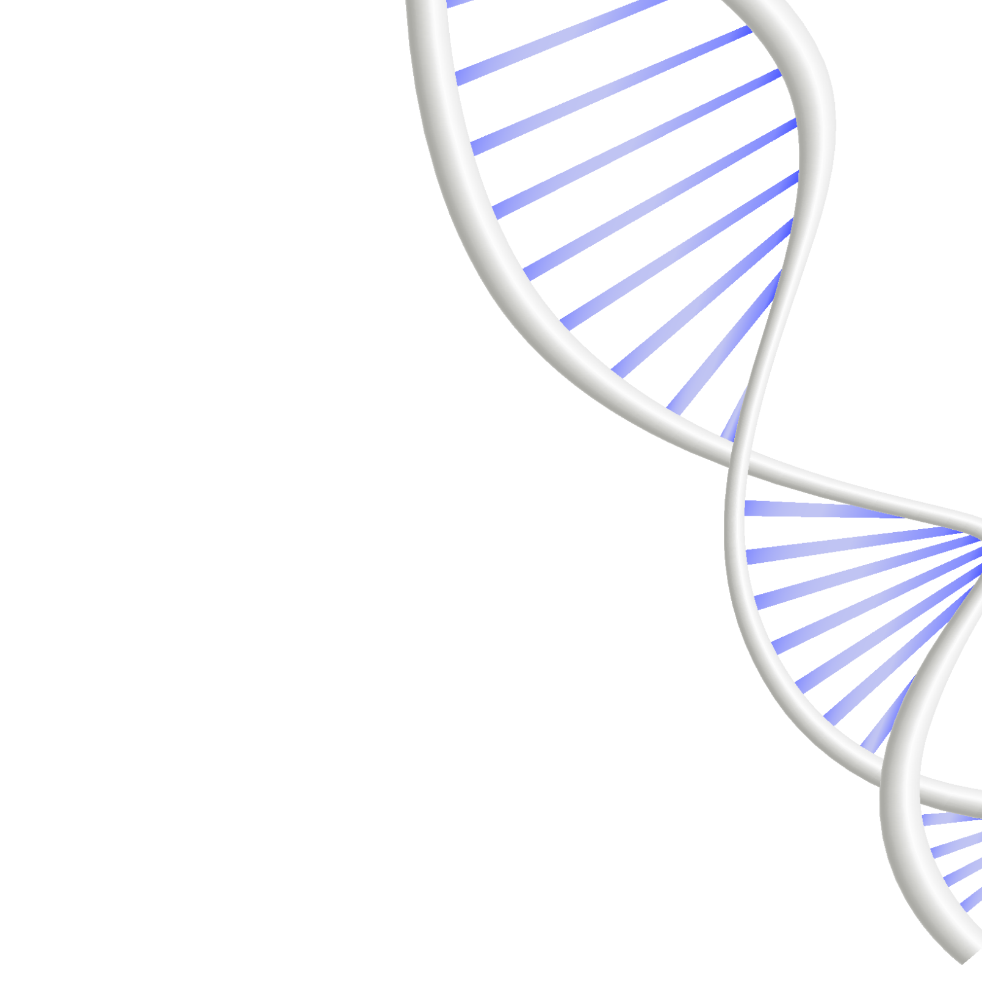
Mutations
Changes in the DNA sequence of single genes
Misspelt genes
Deletions
Duplications / insertions
Disabled
Polymorphisms – natural variations – no adverse effects

Slide 7
Chromosomal mutations
Aneuploidy – Abnormal number of chromosomes
Deletions
Duplications
Insertions
Inversions
Translocations

Slide 8
Laws of Inheritance
AUTOSOMAL DOMINANT
X-LINKED RECESSIVE
AUTOSOMAL RECESSIVE
X-LINKED DOMINANT
MITOCHONDRIAL
1
4
2
5
3

Slide 9
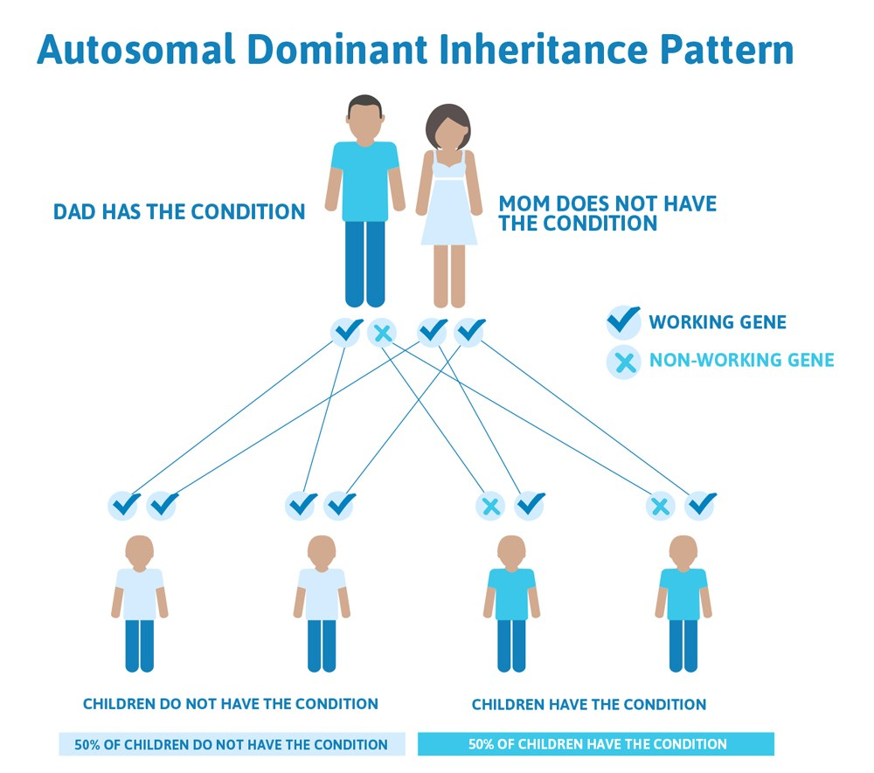

Slide 10
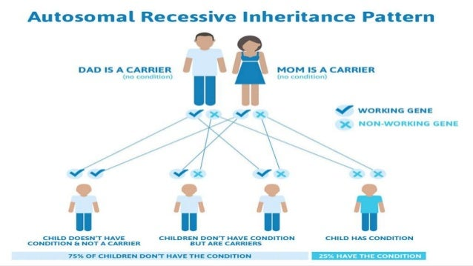

Slide 11
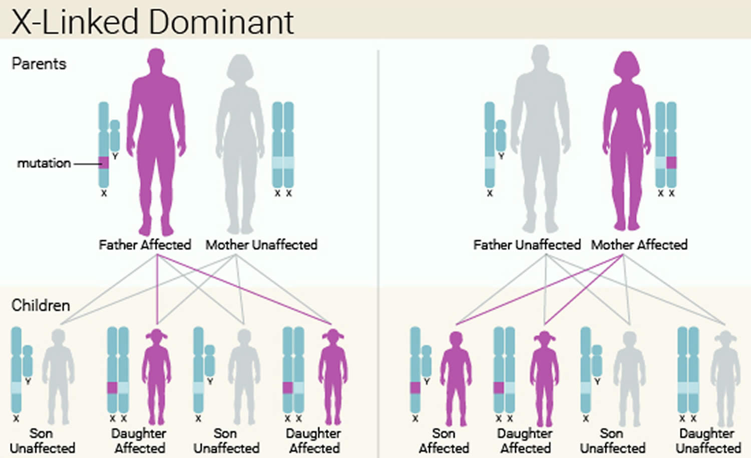

Slide 12
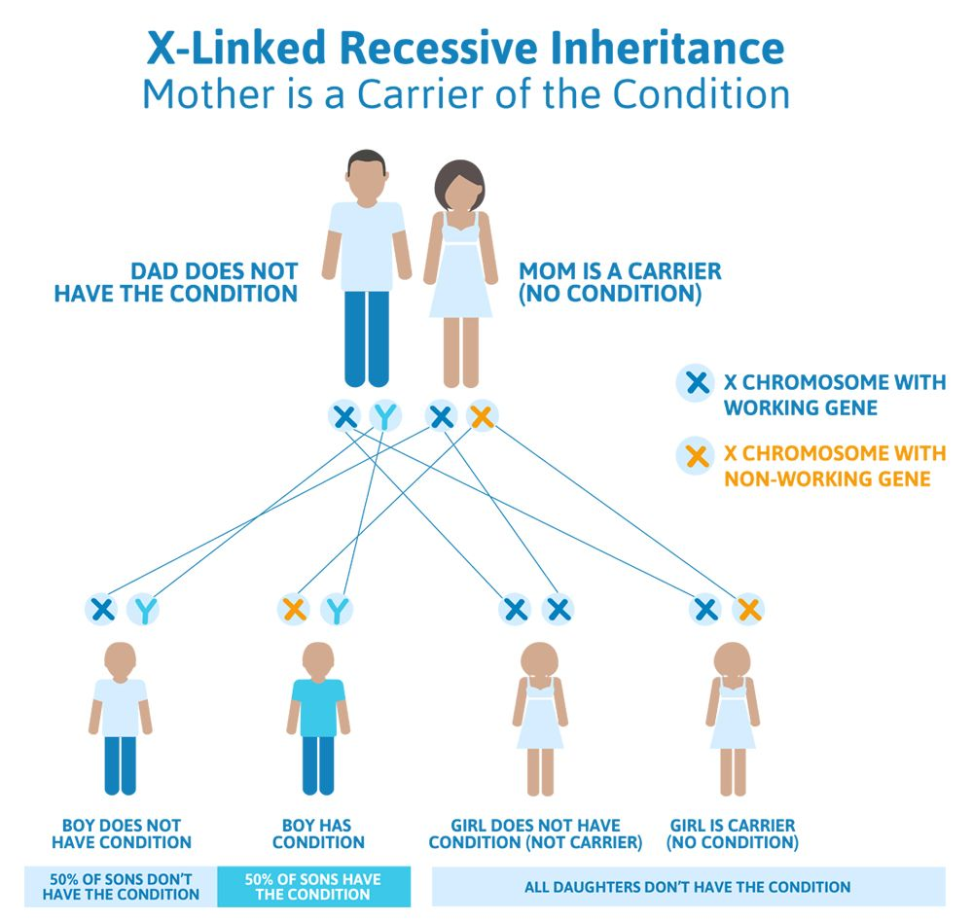

Slide 13
Why genetics in surgery
CVS and amniocentesis – to screen for diseases in the foetus
DIAGNOSIS
Eg: Cystic fibrosis and meconium ileus, FAP and other tumors
ASSOCIATED CONDITIONS/ORGANS
ANAESTHETIC CONSIDERATIONS
Malignant hyperthermia and muscular dystrophies

Slide 14
Why genetics in surgery
Ehler Danlos syndrome, Field effects of mutations
SURGICAL IMPLICATIONS
COUNSELLING/THERAPEUTICS
Give risk estimates for the next pregnancy and screening
Mutation can be targeted for therapy
Preconceptional Folate for spinal dysraphism
Limit teratogens

Slide 15
Common surgical disorders with genetic links
FOREGUT
01
02
MIDGUT
Oesophageal atresia, CCAM, CDH, Lobar anomalies
Liver lesions, Pancreatic anomalies, Small bowel disorders
HINDGUT
03
04
MISCELLANEOUS
ARM, Cloaca, UGS, Motility disorders
Abdominal wall defects, cardiac conditions, neurological disorders, DSD and malignancies

Slide 16
Evaluation
CLINICAL
Dysmorphic facies
Neurocutaneous markers
For counselling
Literature
Planning the future
Sibling screening
Growth assessement
Neurological function
Legal implications
HISTORY
Pedigree chart
ALLIED SPECIALITIES
LABS & IMAGING
Associated abnormalities

Slide 17
Abdominal Wall defects
01
02
03
04
BWS, Omphalocele and gastroschisis
Inheritance - AD
Risk of malignancy – Hepatoblastoma and Wilms’ tumor
Genetic testing and preconceptional counselling

Slide 18
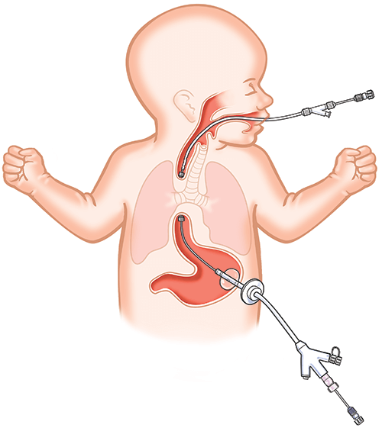
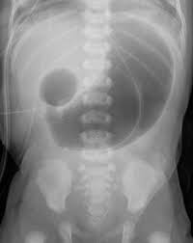
Intestinal Atresias
01
02
03
04
05
EA – VACTERL association
Duodenal atresia – Down syndrome
Anal atresia - VACTERL
Biliary atresia – Alagille syndrome
Meckel diverticulum – Rarely familial

Slide 19
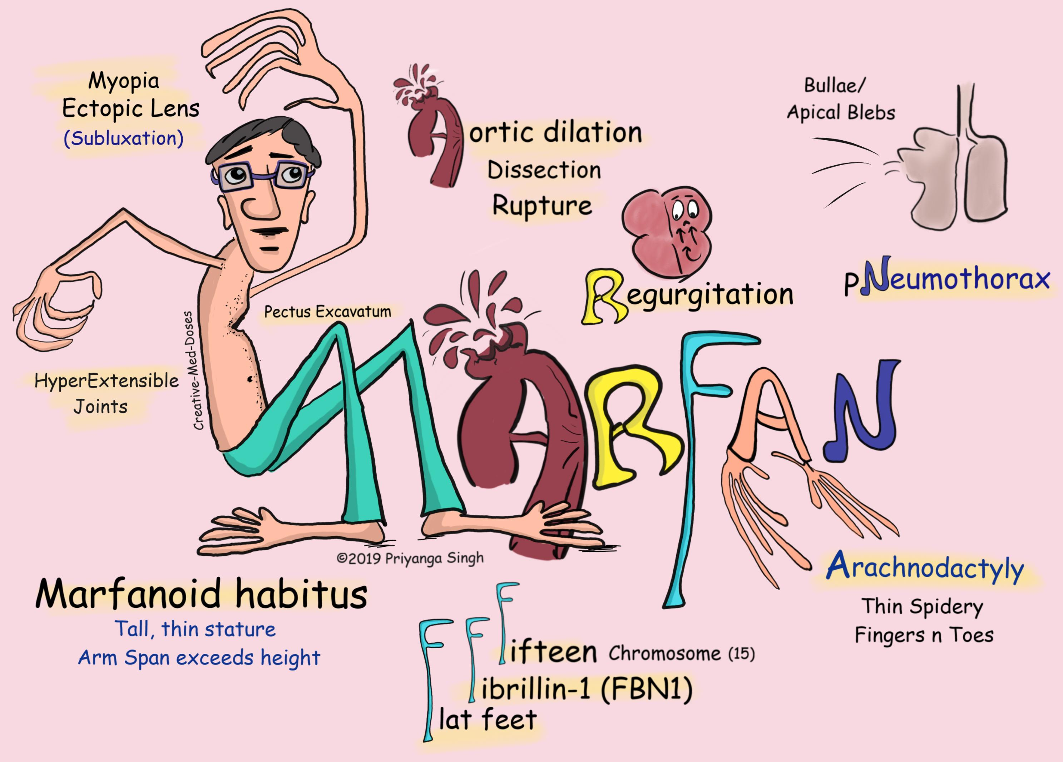
Respiratory System
01
02
03
04
Cystic fibrosis – pancreatitis, meconium ileus
Marfans syndrome – spontaneous pneumothorax, herniae, Pectus excavatum/carinatum
Laryngeal atresia, TEF
Cleft lip and palate

Slide 20
Miscellaneous
01
02
03
04
MEN syndromes and malignancies
FAP, Peutz Jeghers syndrome etc
Motility disorders – Hirschsprung and IND
Cleft lip and palate

Slide 21
Take Home Message
Screen patients with family history of genetic conditions
Watch for conditions with strong associations
Screen for malignancies associated with a diagnosis
Refer to specialist genetic services

Slide 22
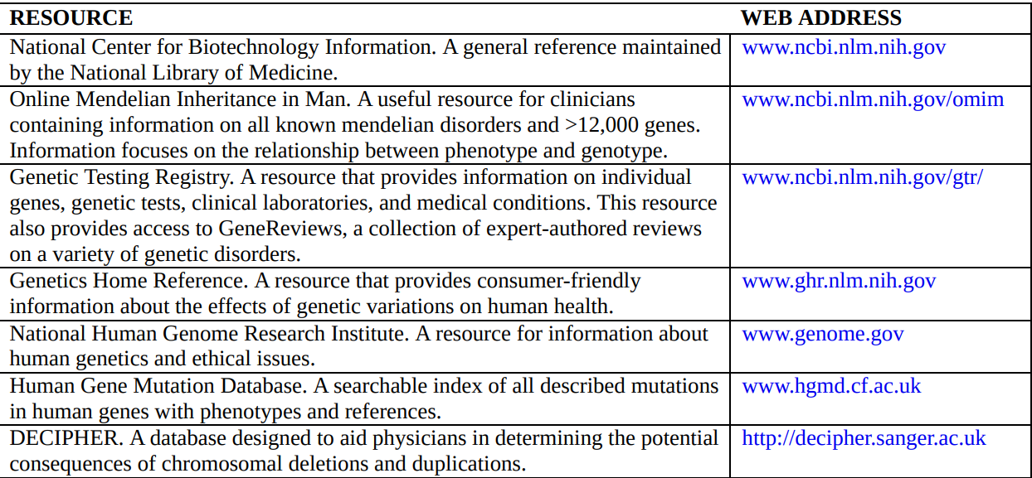
Resources

Slide 23
THANK YOU

